Slide 1
Om Arvadia
1
Marketing Analytics Business Case

Slide 2
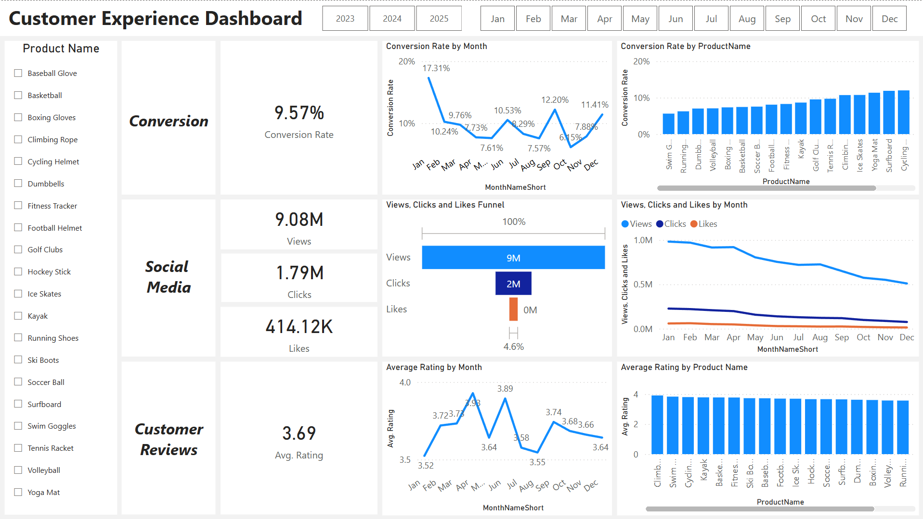
2
Dashboard Overview

Slide 3
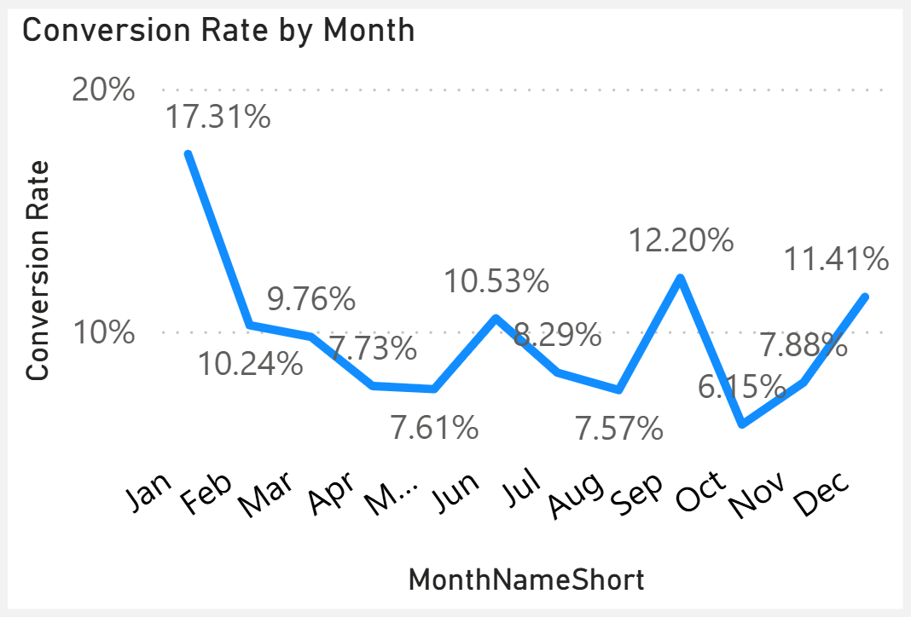
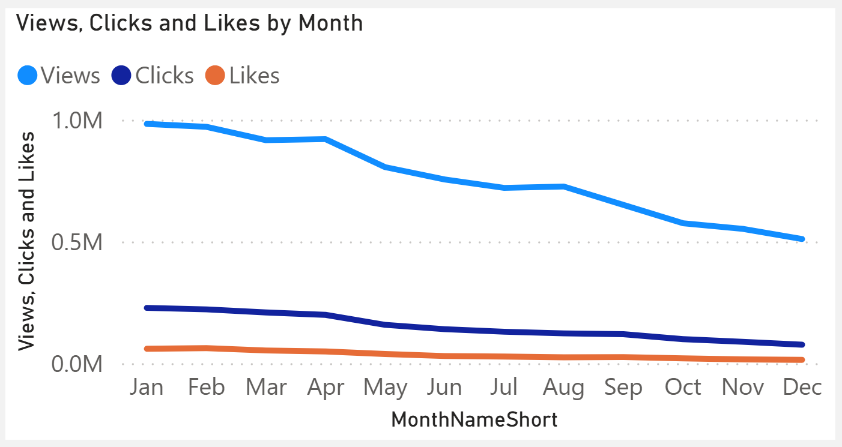
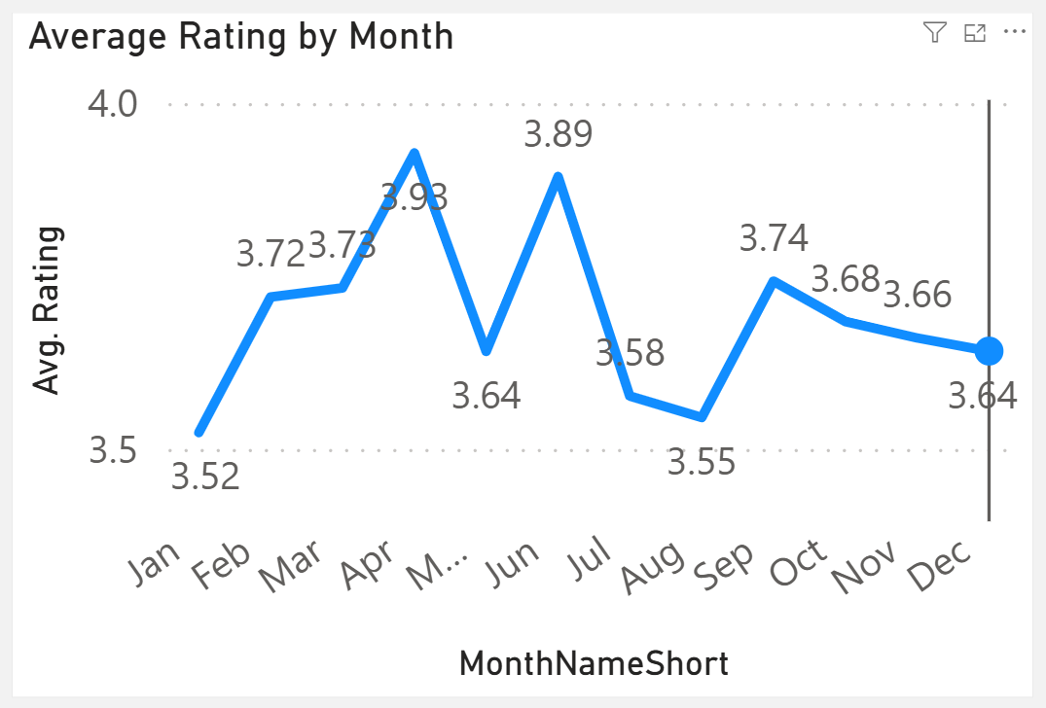
3
General Trends
Decreased Conversion Rates: The conversion rate demonstrated a strong rebound in December reaching 11.41%, despite a notable dip to 6.15% in October
Reduced Customer Engagement: There is a decline in overall social media engagement, with views dropping throughout the year.
Customer Feedback Analysis:
Customer ratings show fluctuations but remain in a relatively consistent range.
Average Rating is below 4 out of 5 suggesting need of improvements.

Slide 4
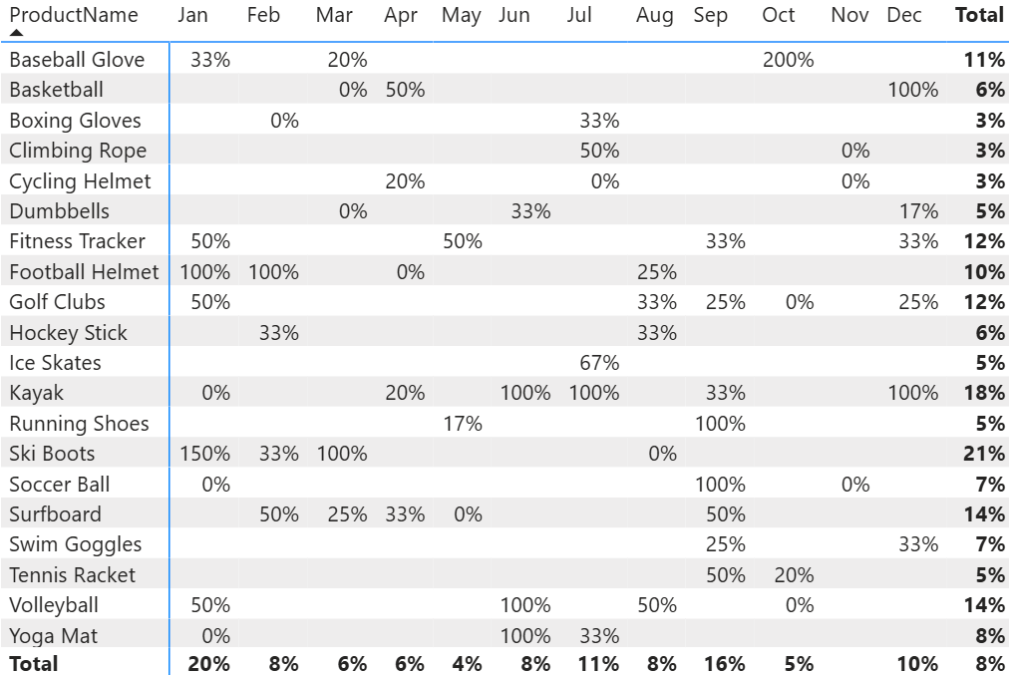
4
Decreased Conversion Rates
General Conversion Trend:
Conversion rates were notably higher in February, July, and September, indicating potential seasonal peaks. To boost performance during lower-conversion months, targeted strategies and interventions can be implemented.
Lowest Conversion Month:
May recorded the lowest conversion rate at 4%, with no standout product performance. This suggests an opportunity to refine marketing strategies or introduce targeted promotions during this period to improve results.
Highest Conversion Month:
January achieved the highest conversion rate at 20%, largely driven by Ski Boots with an exceptional 150% conversion. This strong performance highlights the impact of seasonal demand combined with effective marketing strategies

Slide 5
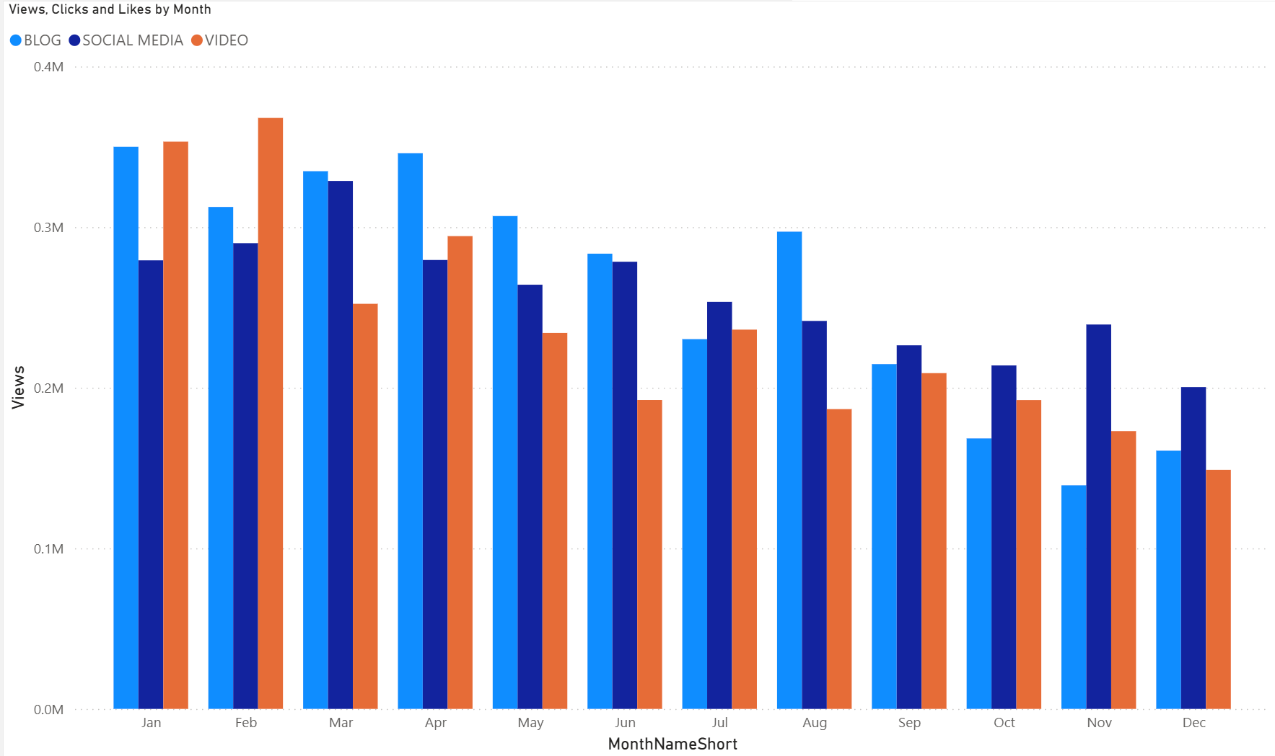
5
Reduced Customer Engagement
Declining Views
Views peaked in February and July but dropped steadily from August onward, signaling reduced audience engagement in the latter half of the year.
Low Interaction Rates
Clicks and likes remained low relative to views, highlighting the need for more engaging content and stronger calls to action.
Content Type Performance
Blog posts drove the highest views, particularly in April and July, while social media and video content performed steadily but with slightly lower engagement

Slide 6
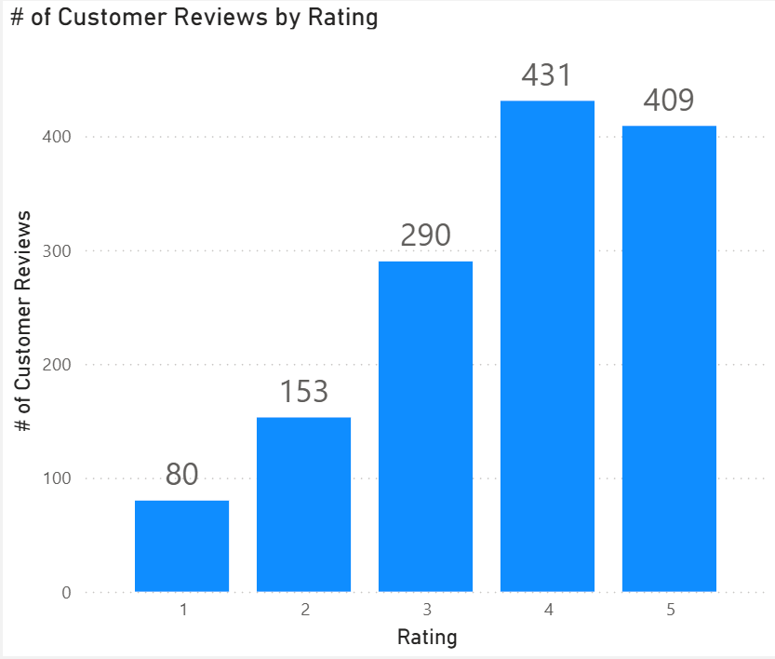
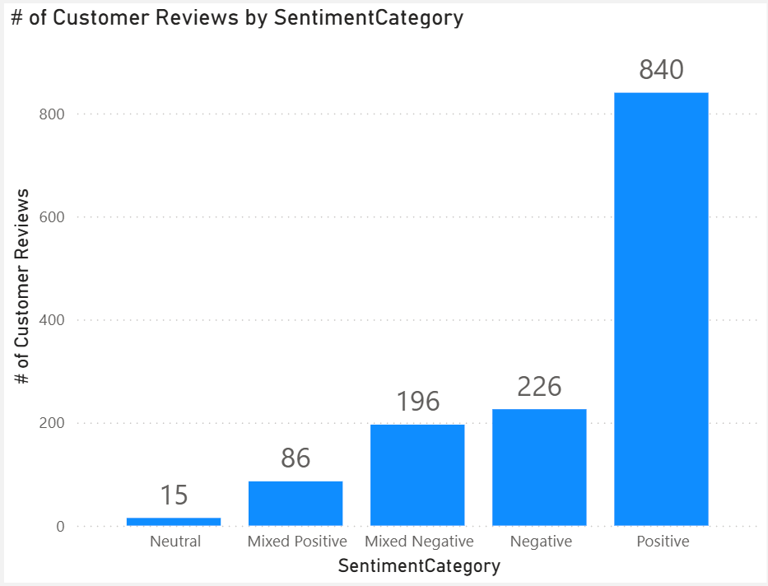
6
Customer Feedback Analysis
Customer Ratings Distribution
Most reviews fall in higher ratings, with 4- and 5-star reviews making up the majority. Lower ratings (1–2 stars) represent only a small share, indicating overall positive customer feedback.
Sentiment Analysis
Positive sentiment dominates with 275 reviews, showing strong customer satisfaction. Negative and mixed sentiments are fewer but highlight areas for improvement.
Opportunity for Improvement
Mixed reviews reveal opportunities to address specific concerns, turning neutral or negative experiences into positive ones, which could further enhance overall satisfaction and ratings.

